Slide 1


Notes:
Our team consisted of Kasey, Sarah Klein, Chase and myself. We were interested in digging into Spotify as it represents a significant platform for music consumption.

Slide 2
Questions to Answer
What are the most popular genres and artists?
What are the most popular artists for each decade?
How are the ratings skewed? (i.e. what percentage fall into different ratings)
Which artists have the most tracks on Spotify?
Is there a correlation between popularity and the following?
Length of track
Danceability score
Explicit
Release Date
Artist
Notes:
Questions you found interesting and what motivated you to answer them
BRAD TO PRESENT - Chase next with where we obtained our data.

Slide 3
Data Utilized
Kaggle - Spotify Dataset 1921-2020
Content
The "data.csv" file contains more than 175,000 songs collected from Spotify. Five different csv files included:
Data.csv
Data_by_artist.csv
Data_by_genres.csv
Data_by_year.csv
Data_w_genres.csv
Each row represents a field of the track (audio features and identifiers)
Notes:
Where and How we found the data
Chase reads

Slide 4
Audio Features & Identifiers
Primary:
id (Id of track generated by Spotify)
Numerical:
acousticness (Ranges from 0 to 1)
danceability (Ranges from 0 to 1)
energy (Ranges from 0 to 1)
duration_ms (Integer typically ranging from 200k to 300k)
instrumentalness (Ranges from 0 to 1)
valence (Ranges from 0 to 1)
popularity (Ranges from 0 to 100)
tempo (Float typically ranging from 50 to 150)
liveness (Ranges from 0 to 1)
loudness (Float typically ranging from -60 to 0)
speechiness (Ranges from 0 to 1)
year (Ranges from 1921 to 2020)
Dummy:
mode (0 = Minor, 1 = Major)
explicit (0 = No explicit content, 1 = Explicit content)
Categorical:
key (All keys on octave encoded as values ranging from 0 to 11, starting on C as 0, C# as 1 and so on…)
artists (List of artists mentioned)
release_date (Date of release mostly in yyyy-mm-dd format, however precision of date may vary)
name (Name of the song)
popularity- The value will be between 0 and 100, with 100 being the most popular. The artist’s popularity is calculated from the popularity of all the artist’s tracks.
Notes:
Chase Reads

Slide 5
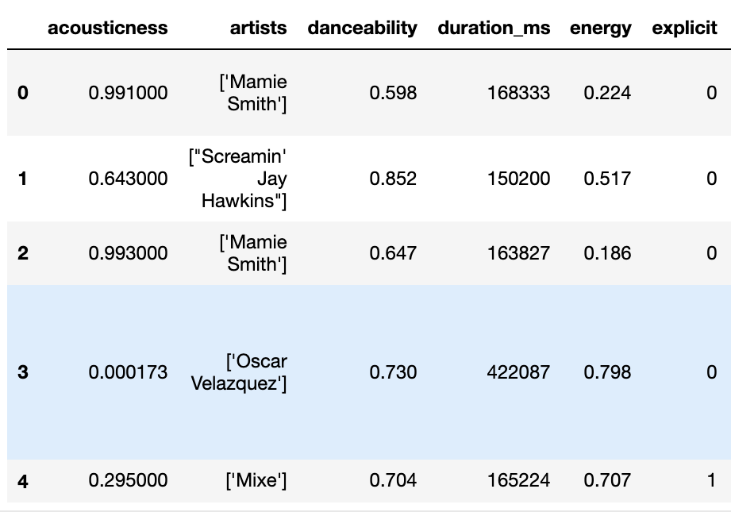
Data Exploration and Cleanup
As part of the data exploration we reviewed data sets pertaining to Spotify to determine what data is available.
After importing the csv files and further reviewing the datasets using .value_counts() and .describe() we determined that we could answer our questions using the data sets independently.
We also found that the data sets had vastly different numbers of data points, so we decided not to merge and utilize separately.
Example of raw DataFrame
Notes:
The data exploration and cleanup process (accompanied by your Jupyter Notebook)
KASEY TO PRESENT

Slide 6
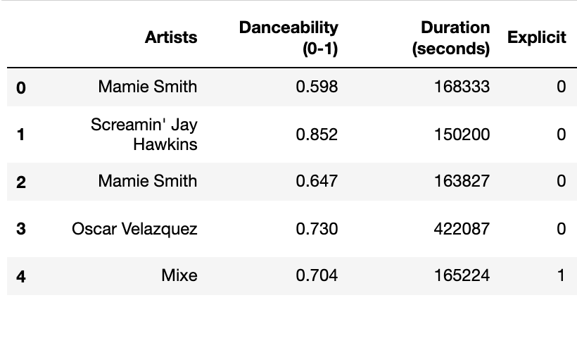
Data Exploration and Cleanup
Once we import the csv files as dataframes we further reviewed the data points to determine what formatting adjustments needed to be completed.
We found that the artists column needed to remove the brackets and quotes, so we found a function to remove those characters.
We updated the dataframe to only include the columns that were relevant for part of the analysis and re-named the column titles to provide better clarity.
Example of cleaner DataFrame
Notes:
KASEY TO PRESENT

Slide 7
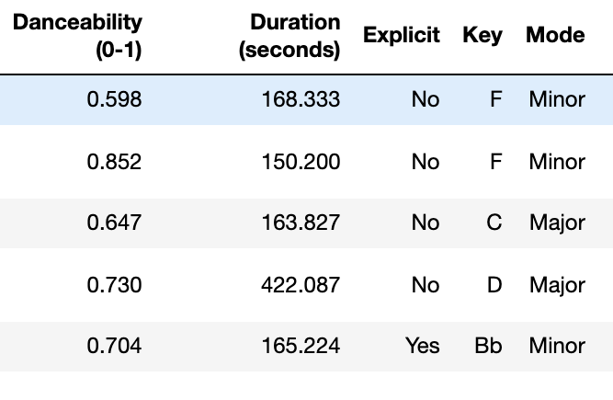
Data Exploration and Cleanup
Lastly, we found that some of the column values were not easy to understand.
For example, "Explicit" was indicated with a 0 or 1, so this was updated to be either "No" or "Yes."
We also updated the duration in ms to be in seconds.
For Mode and Key we also updated numeric values to be a descriptive string value.
Example of clean DataFrame
Notes:
KASEY TO PRESENT

Slide 8

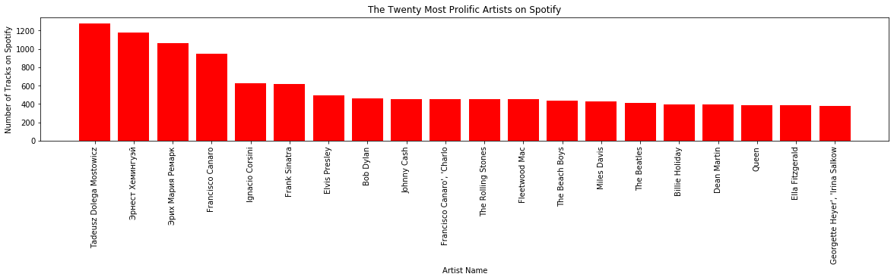
Which artists have the most tracks on Spotify?
Used the value.counts function to find number of tracks for each artist.
Used the reset.index function to make it a dataframe.
Created a MatPlotLib Bar Chart to visualize the 20 most prolific artists.
Notes:
The analysis process (accompanied by your Jupyter Notebook)

Slide 9

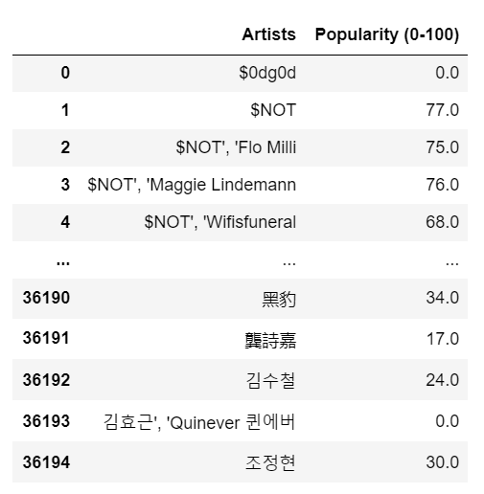
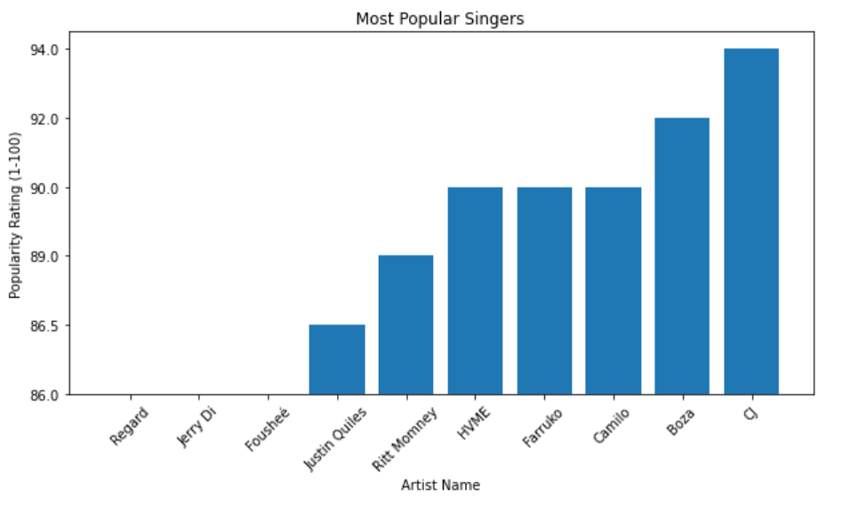
Artist’s With Highest Average Popularity
Artist’s inconsistently had special characters
With time constraint, dropped Artist’s with special characters
Notes:
With the limitation of time and data, I pivoted to find the top 10 artist’s with the highest average popularity which is seen on the right.

Slide 10
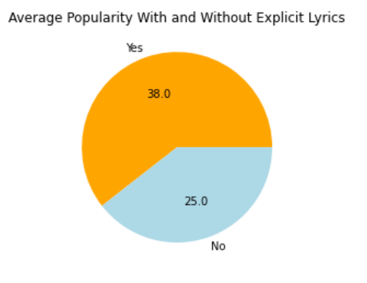
Cursing in Songs vs Clean Songs Only
Songs With Explicit Lyrics are Slightly More Popular
Learned How To Convert The Values Of Each Pie Piece From Percentages
Notes:
The tough part for this was figuring out how to give each piece of the pie a value without being a percentage since this wasn't about adding up to 100.

Slide 11
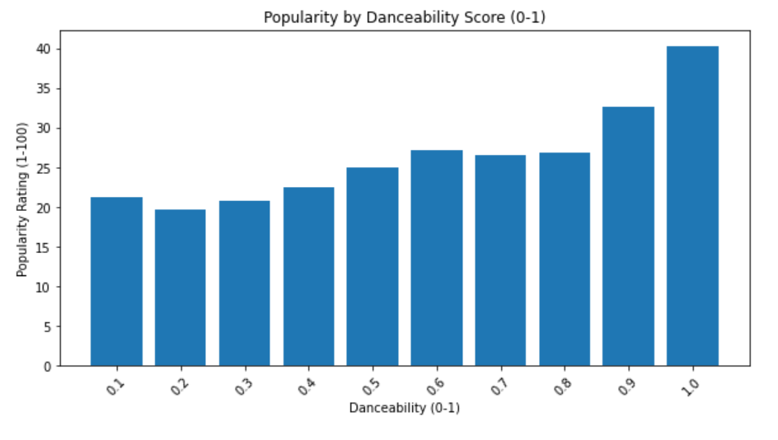
Popularity by Danceability
Correlation Between Popularity and Danceability is 0.9
How suitable a track is for dancing based on musical elements including
tempo
rhythm stability
beat strength
overall regularity
Hypothesis: The more danceable a song is the more popular it would be.
Conclusion: We were right! It has a whopping .9 on Pearson's correlation coefficient
Notes:
People like to bop and dance! Next up, we have Kacey

Slide 12

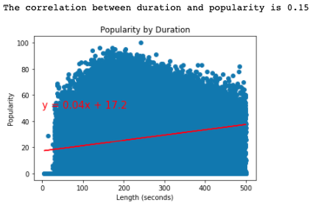
Popularity by Duration
Compared duration in seconds to popularity ratings
Filtered to < 500 seconds (8.33 min)
Plotted to calculate correlation coefficient
Notes:
The analysis process (accompanied by your Jupyter Notebook)

Slide 13
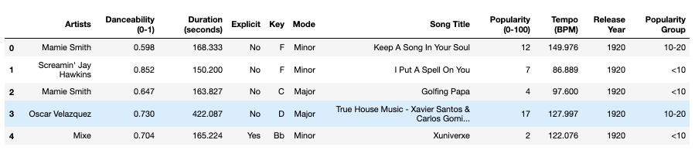
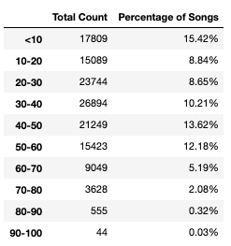
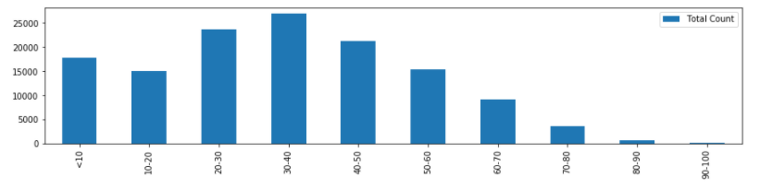
How are the Ratings Skewed?
Created bins for different popularity groupings (0-100)
Added the popularity group
Calculated percentage
Notes:
The analysis process (accompanied by your Jupyter Notebook)

Slide 14

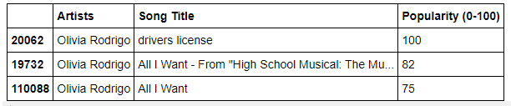
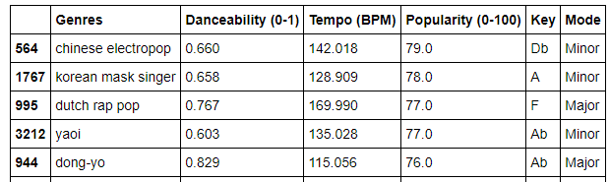
Most Popular Genre and Artist
By sorting the cleaned data, we found that Olivia Rodrigo is the most popular artist, while Chinese Electropop is the most popular genre.

Slide 15
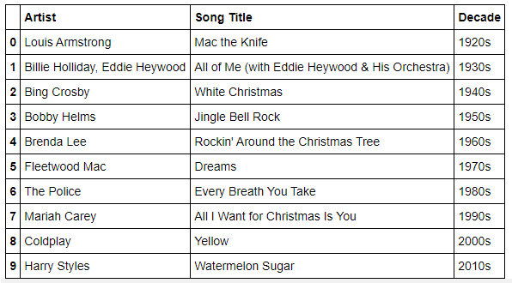
Most Popular Artist by Decade
For every decade from the 1920s to the 2010s, we were able to find the current most popular artist of each group. This data was then placed into its own dataframe.
Notes:
After placing release year into bins categorized by decade, each decade then received its own dataframe sorted by popularity in descending order.

Slide 16
Conclusions & Implications
Less than 3% of songs are “popular” (70+ popularity score)
There is little to no correlation between duration of track and popularity.
Through the analyzed data, it can be inferred that the likely demographic using Spotify is the 18-39 age range, based on release date of the most popular songs.
The majority of most popular songs by decade were Christmas songs, likely skewed by the recent holiday.
The most “prolific” artists are actually authors.
The most popular genre was Chinese Electropop, showing the influence of the Eastern entertainment industry on Western entertainment.
Notes:
We also learned that the most popular genre was Chinese Electropop. OR It would be interesting to revisit this project later in the course once we’ve learned these skills.

Slide 17
Questions?

